Slide 1
Use Investor Sentiment to Predict Future Price Movement in the U.S. Stock Market Based on the Financial Social Media Platform
Yulun Han
MACS 36000

Slide 2
Literature Review – Investor Sentiment
Pagolu found that a strong correlation exists between the rise and falls in stock prices with the public sentiments in tweets (Pagolu et al., 2016).
Another research is shown that the change of stock prices can be predicted by public sentiment (Ni et al., 2019).
Notes:
- Most previous studies devoted to establishing the relationship between public sentiment and stock market movement use data from the Twitter/Reddit,
- However, twitter do not embody a large number of emotional investor trends.
- Therefore, those Previous research about public sentiment give the reason why I choose investor sentiment to investigate in my research
- Stocktwits is focused on financial instrucments
The argument against the belief that investor sentiment affects stock prices is that any effects caused by sentiment should, in theory, be eliminated by rational traders seeking to exploit the profit opportunities created by mispricings. However, if there are limits to arbitrage, rational traders cannot fully exploit such opportunities—and sentiment effects become more likely.反对投资者情绪会影响股价的观点是，从理论上讲，任何由情绪引起的影响都应该被理性的交易员消除，他们试图利用错误定价带来的利润机会。然而，如果存在套利限制，理性的交易者就无法充分利用这些机会——情绪效应就更有可能出现。
Arbitrage: arbitrage is the practice of taking advantage of a difference in prices in two or more markets

Slide 3
Research Questions
To check whether stock sectors can be classified according to the level of investor interest.
Based on the results of social network analysis for stock classification, using investor sentiment scores to predict stock prices and comparing the accuracy of the prediction model between those two stock sector classifications.

Slide 4
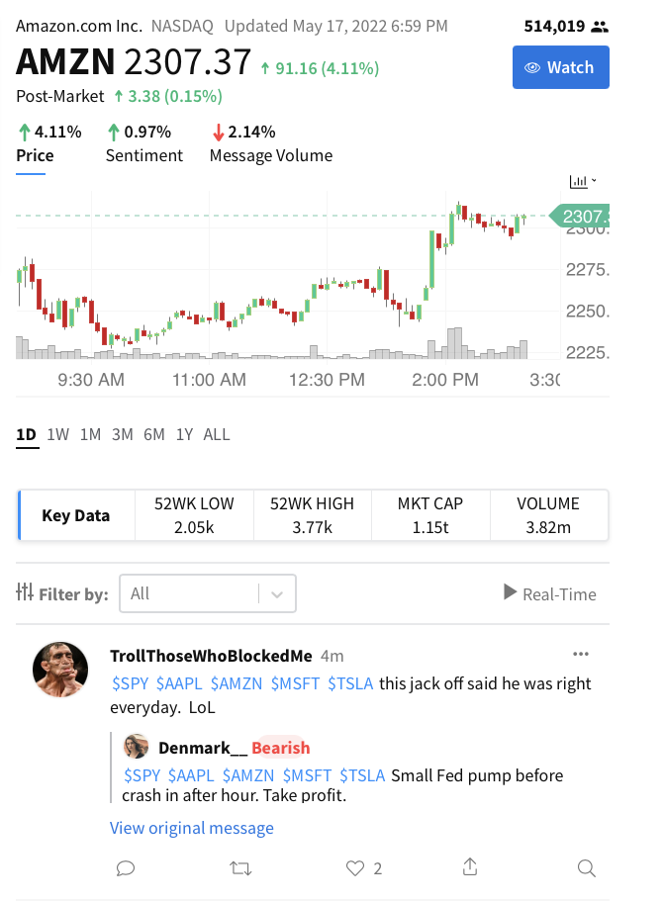
Data
Market data
Yahoo Finance
Social media data
StockTwits.com
Investor sentiment data
Polarity based on sentiment analysis
Harvard IV-4 sentiment dictionary
Notes:
There 3 part for data
- StockTwits: Different from those general social networks, such as twitter/facebook,
- almost all the information on StockTwits is directly related to stocks or other financial instruments,
so, it is a natural data source to collect investors’ perceptions
And here is a quick view for stocktwits, the highlight part is user posts, I collect the them for sentiment analysis
It is the sentiment score which I calculate post’s polarity based on sentiment analysis

Slide 5
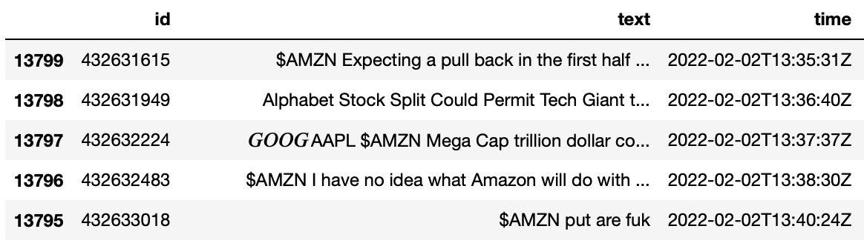
Data – Social Media Data
50 stocks in 5 different sectors
Communication Services
Consumer Discretionary
Financial
Health Care
Information Technology
Investors’ posts in the recent 50 trading days
50 stocks have 508,000 posts
TSLA: 170,000 posts
FOXA: 120 posts
Notes:
The research focuses on 50 stocks that are the holdings of S&P 500 Top 50 index. The S&P 500 Top 50 consists of 50 of the largest companies from the S&P 500, reflecting U.S. mega-cap performance. The
50 target stocks belong to five different sectors, each sector containing 10 stocks

Slide 6
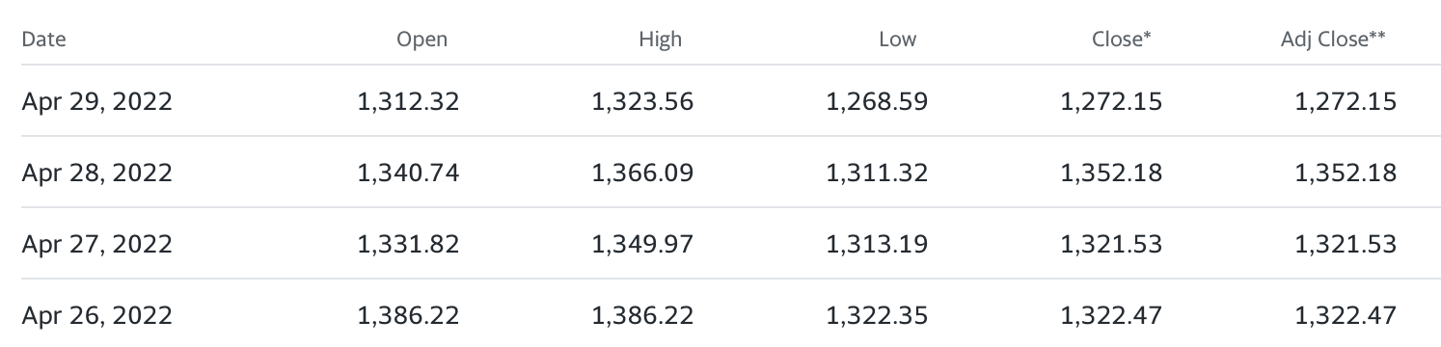
Data – Market Data
Daily adjusted closing price as dependent variable
S&P 500 Consumer Discretionary index (ticker: ^SP500-25)
S&P 500 Health Care index (ticker: ^SP500-35)
S&P 500 Financials index (ticker: ^SP500-40)
S&P 500 Info Tech index (ticker: ^SP500-45)
S&P 500 Communication Services (ticker: ^SP500-50)
Notes:
The market data consists of historical daily data from five target sector index,
S&P Sector and Industry Indices measure segments of the U.S. stock market
The 50 target stocks also include in those 5 sector index respectively
i chose adj close as dep variable in later analysis

Slide 7
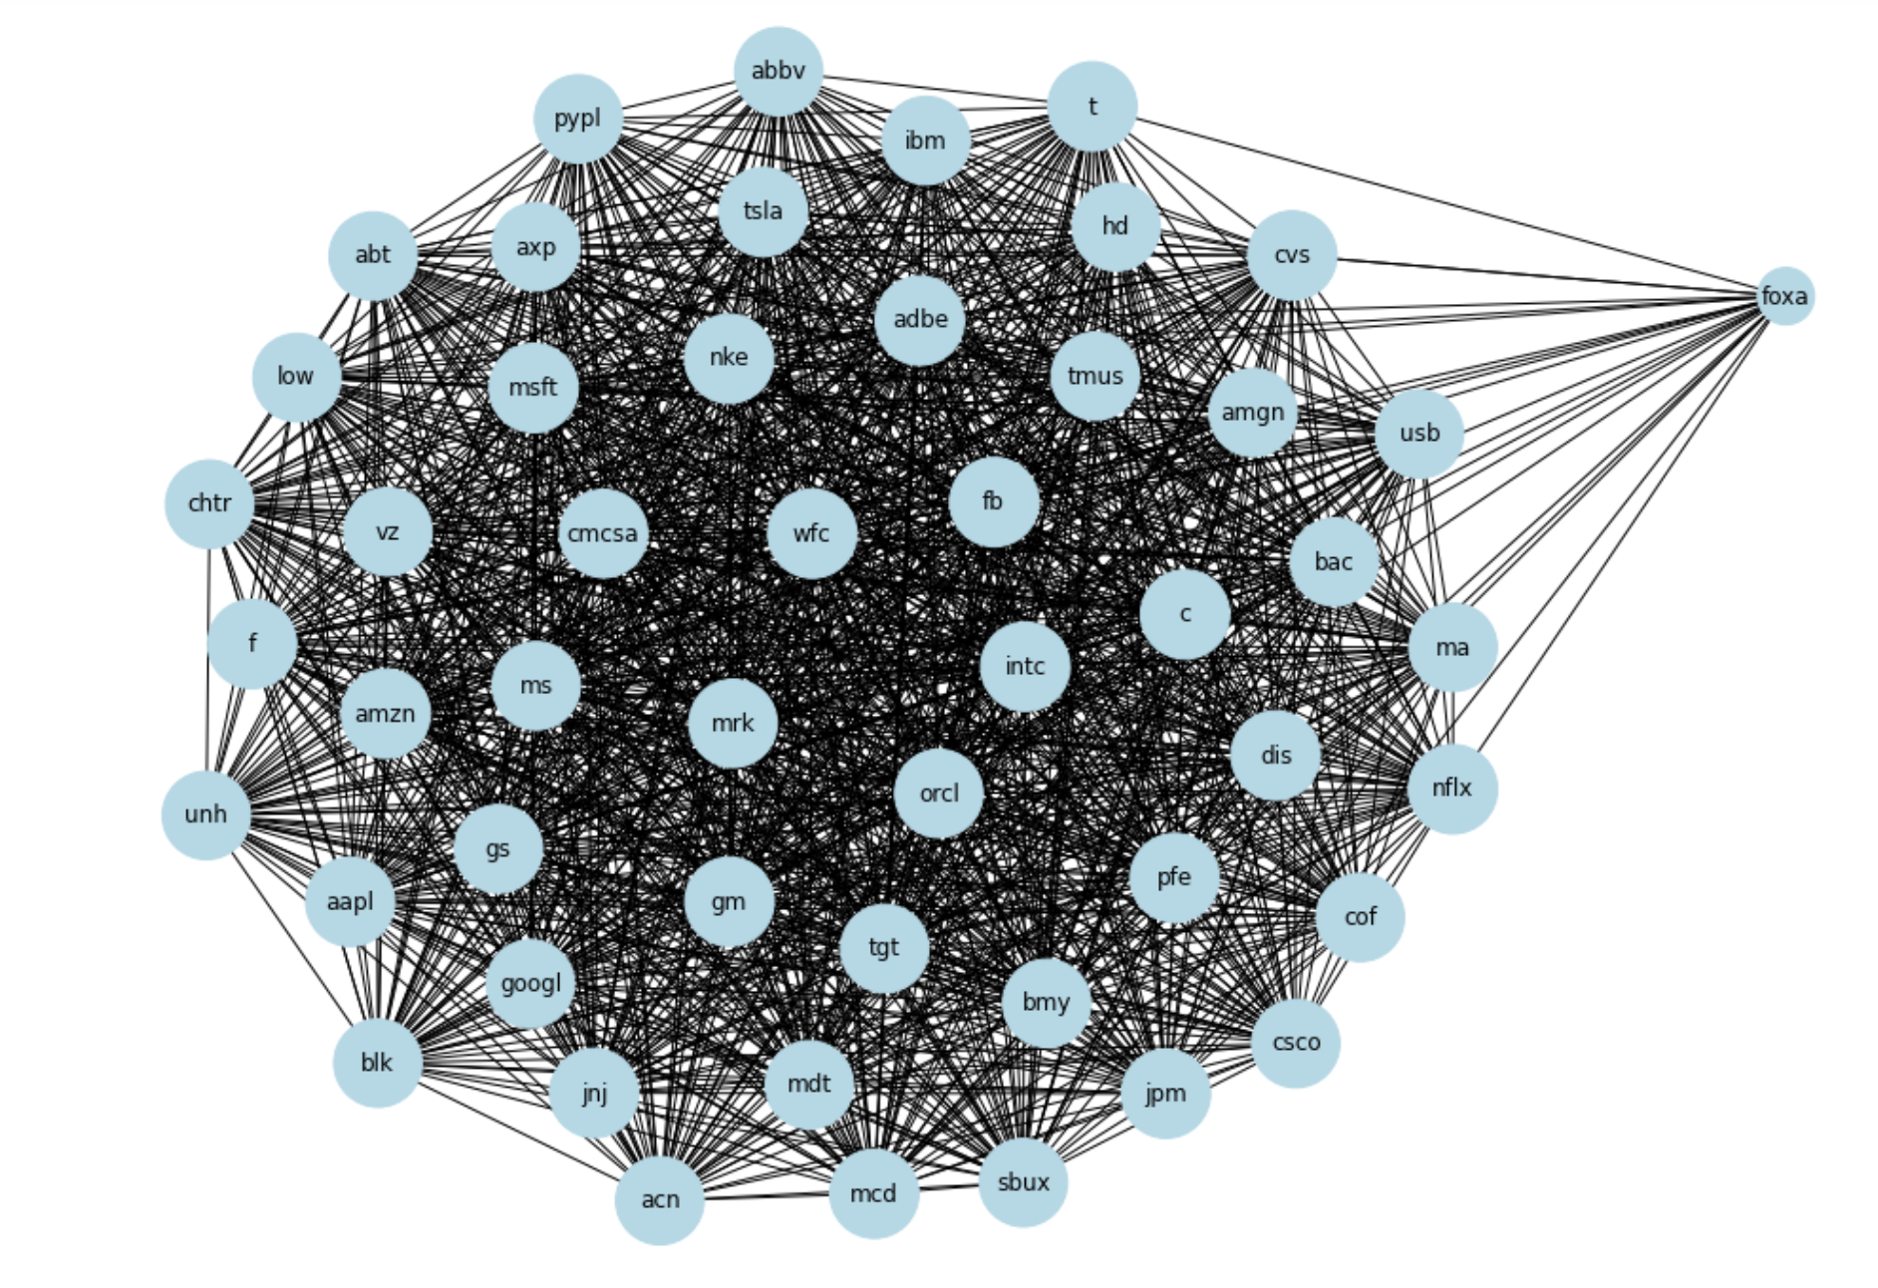
Method 1 - Graph Representation
50 nodes
1196 edges
23 and more common users
“foxa” has the lowest number of posts
Notes:
I defined 50 target stocks as nodes and the number of users who jointly commented as edges.
When every two stocks have 23 or more common users, an edge will be generated between the two stocks
There are 50 nodes and 1196 edges in the graph.
We can find out that 49 nodes are tightly connected, except for "foxa".
The reason for this result may be “foxa” has the lowest number of posts compared to the other 49 stocks

Slide 8
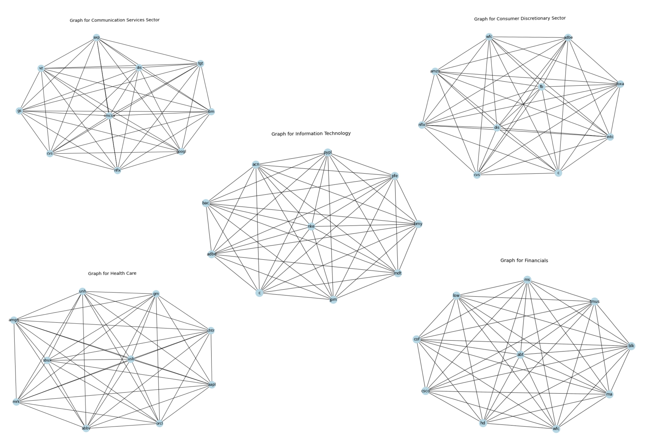
Method 2 - Community Detection
Laplacian Matrix = Degree Matrix - Adjacency Matrix
Second Eigenvector
Notes:
Based on the results obtained from the graph representation,
I decided to reclassify the 50 target stocks using the community detection with the method of the second eigenvector of the Laplacian matrix
And the graph is the 5 communities I detected

Slide 9
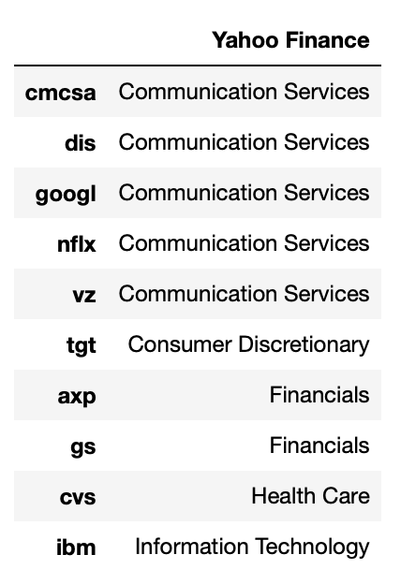
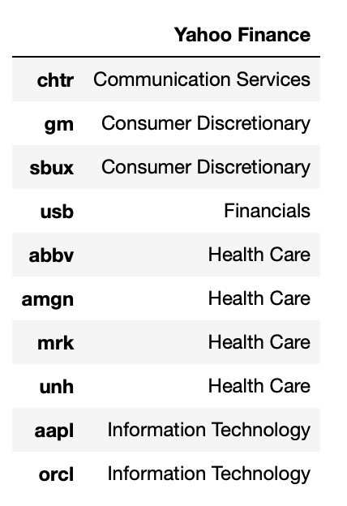
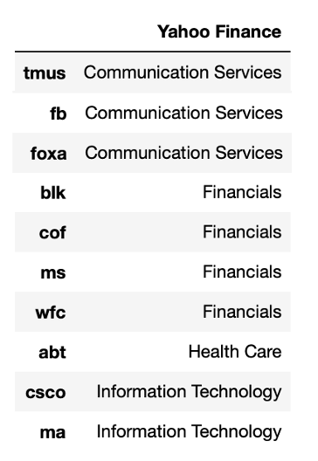
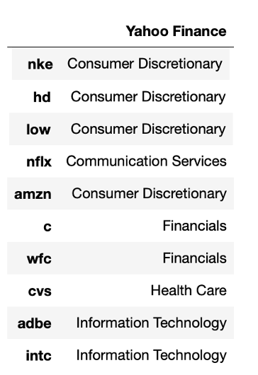
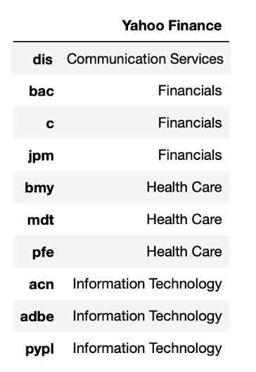
Notes:
Here is the detailed information of each community
Let‘s use the upper left table as an example
The first column contains the 10 stocks of the first community
The second column shows the sector of these stocks in Yahoo Finance
In the first community, Most of the stocks are communication service stocks, so I define this community as a communication service sector
The remaining communities also used a select majority approach to define their new sector

Slide 10
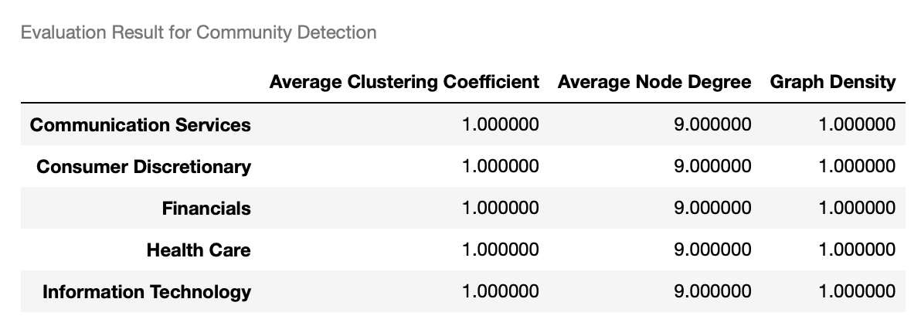
Evaluation - Community Detection
Fully connected
Notes:
The evaluation result for five community. Their average clustering coefficient are all equal to 1,
which means each community are fully connected

Slide 11
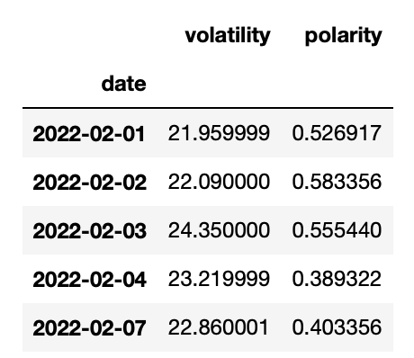
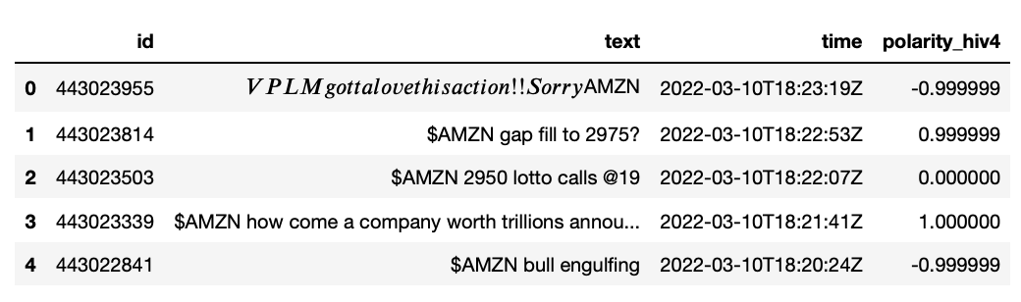
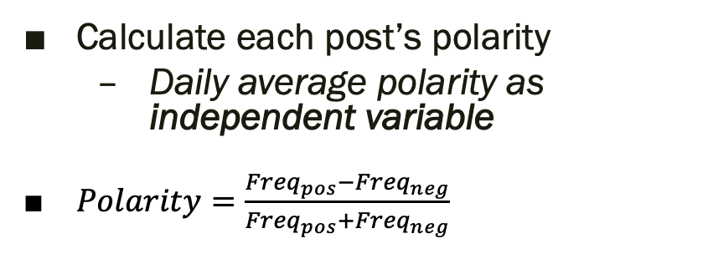
Method 3 - Sentiment Analysis
Calculate each post’s polarity
Daily average polarity as independent variable
$Polarity=\frac{{Freq}_{pos}−{Freq}_{neg}}{{Freq}_{pos}+{Freq}_{neg}}$
Notes:
I Calculate each post’s polarity,
and then calculate Daily average polarity to represent investor sentiment score
In the later regression model, investor sentiment score will be the indep variable
Using Harvard IV-4 sentiment dictionary as frequency dictionaries to count the positive and negative frequencies of each word in the social media data.
The final step is to calculate polarity for each post by using the following formulas:

Slide 12
Method 4 - Random Forest Regression
Independent variables: daily sentiment scores for 10 stocks
Dependent variable: the daily adjusted closing price of the stock sector index
The recent 50 trading days
Notes:
- To better predict the stock price, this research builds a random forest regression model to predict the stock price based on investor sentiment.
The stock prediction model is constructed for each of the five sectors,
in which the daily sentiment scores for 10 stocks are the independent variables,
and the daily adjusted closing price of the stock sector index is the dependent variable

Slide 13
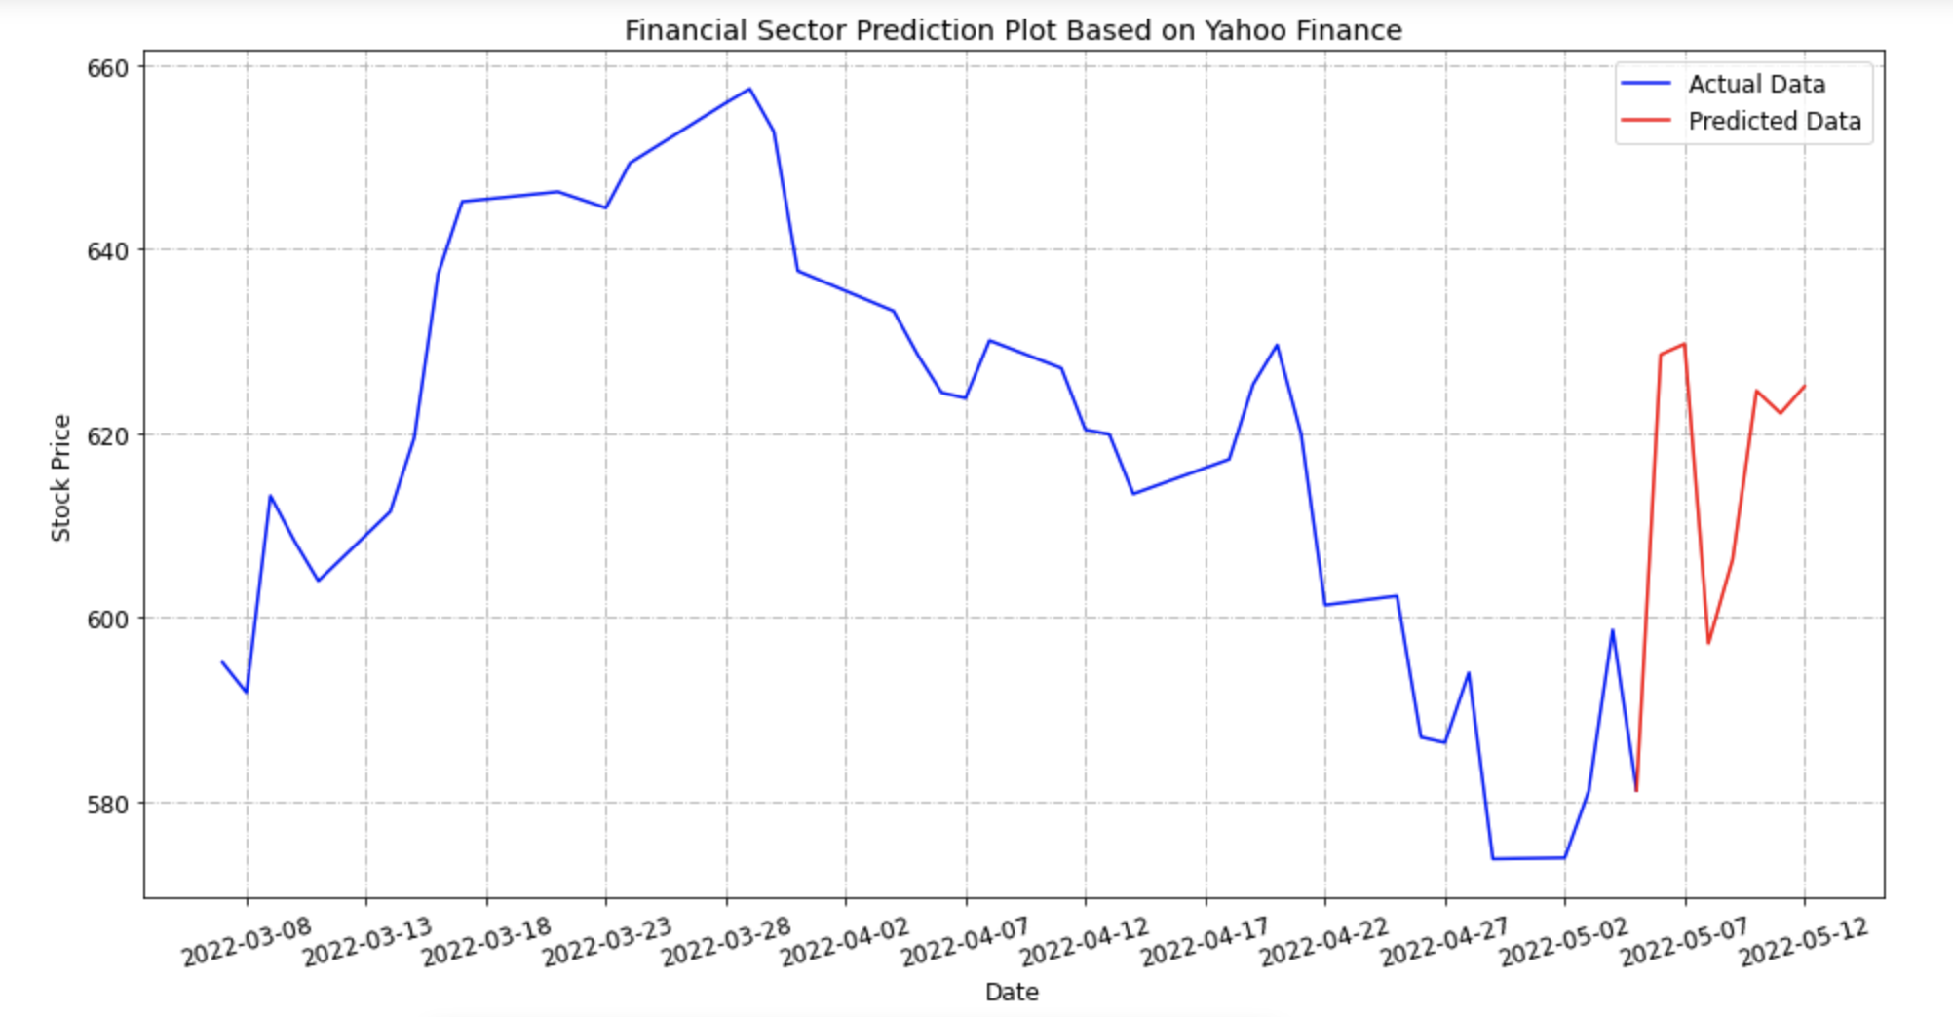
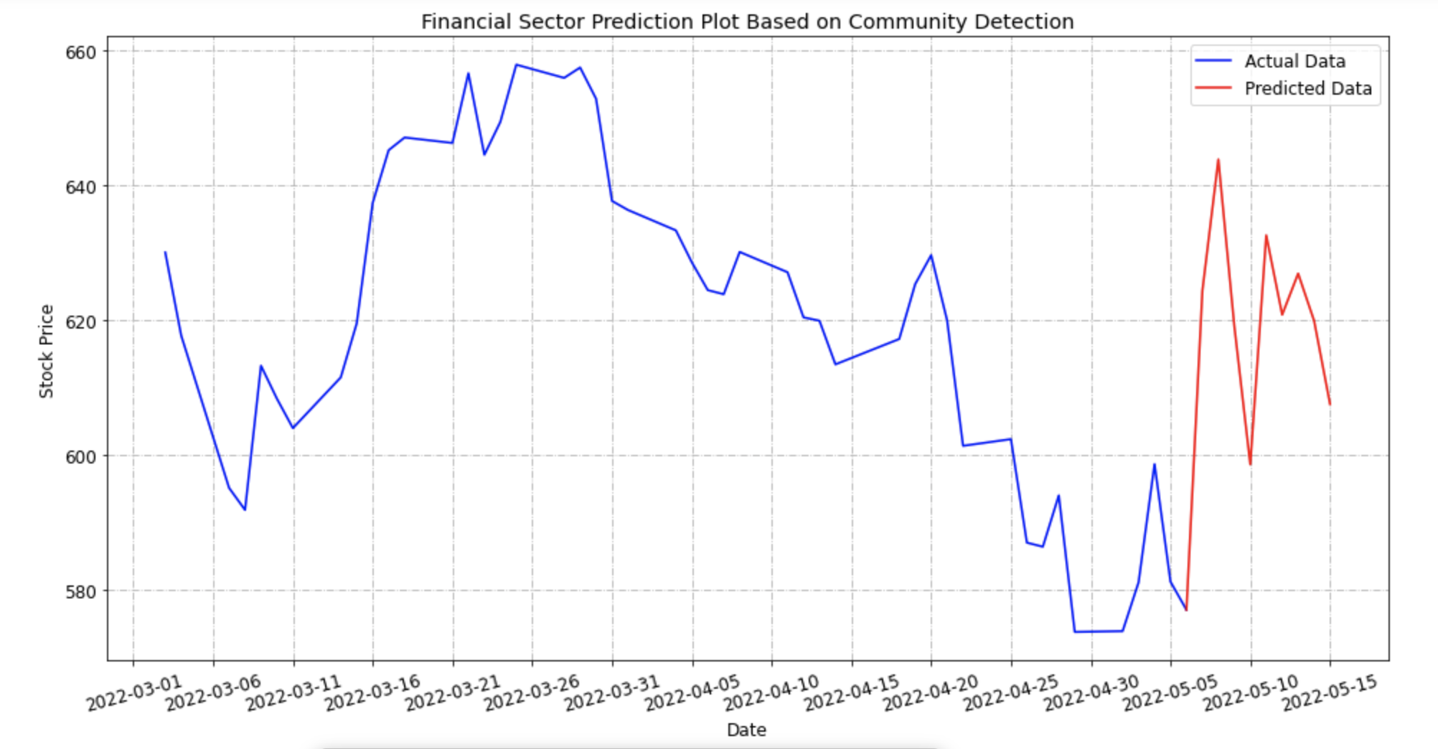
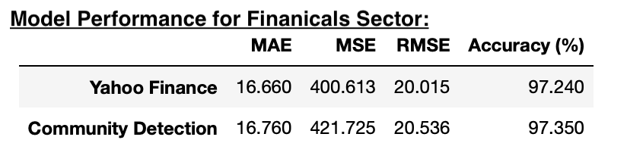
Method 4 - Financials Sector
Evaluation Results:
Notes:
For financials sector, in the right hand side is the result after stock price prediction,
The blue line is the actual price, the red line the predicted price
The upper plot is the result based on the yahoo finance sector classification
The bottom plot is based on community detection sector classification
Let’s check the error analysis result, we can find out the accuracy of the model based on community detection sector classification is higher than the model based on the yahoo finance sector classification

Slide 14
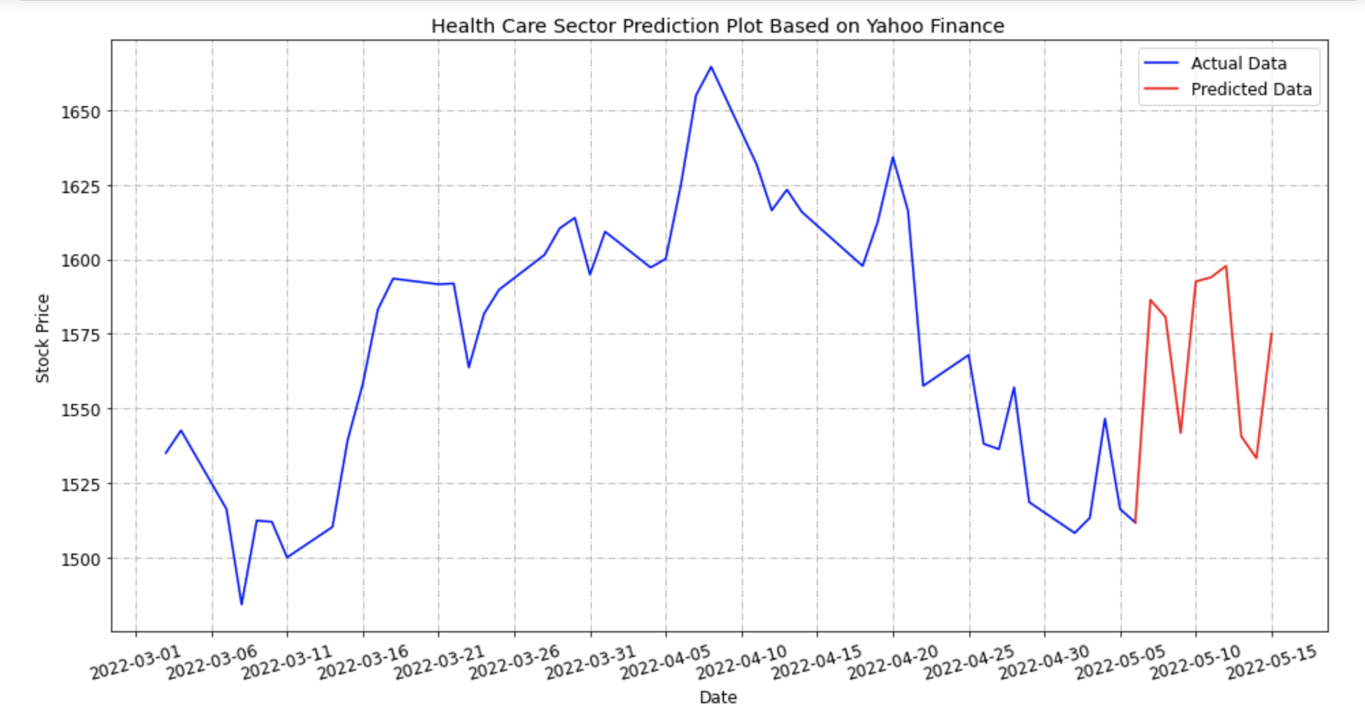
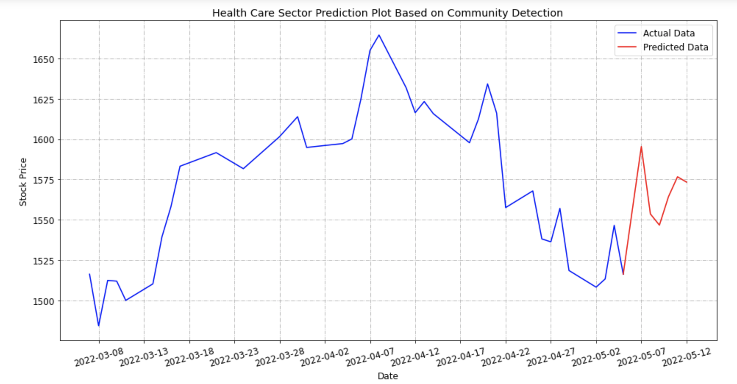
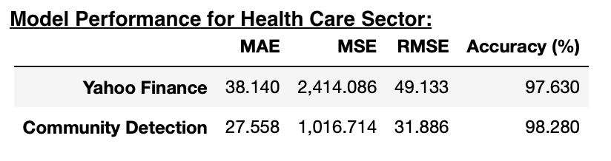
Method 4 – Health Care Sector
Evaluation Results:
Notes:
For the next three sectors, I got the same results that the accuracy of the model based on community detection’s sector are higher

Slide 15
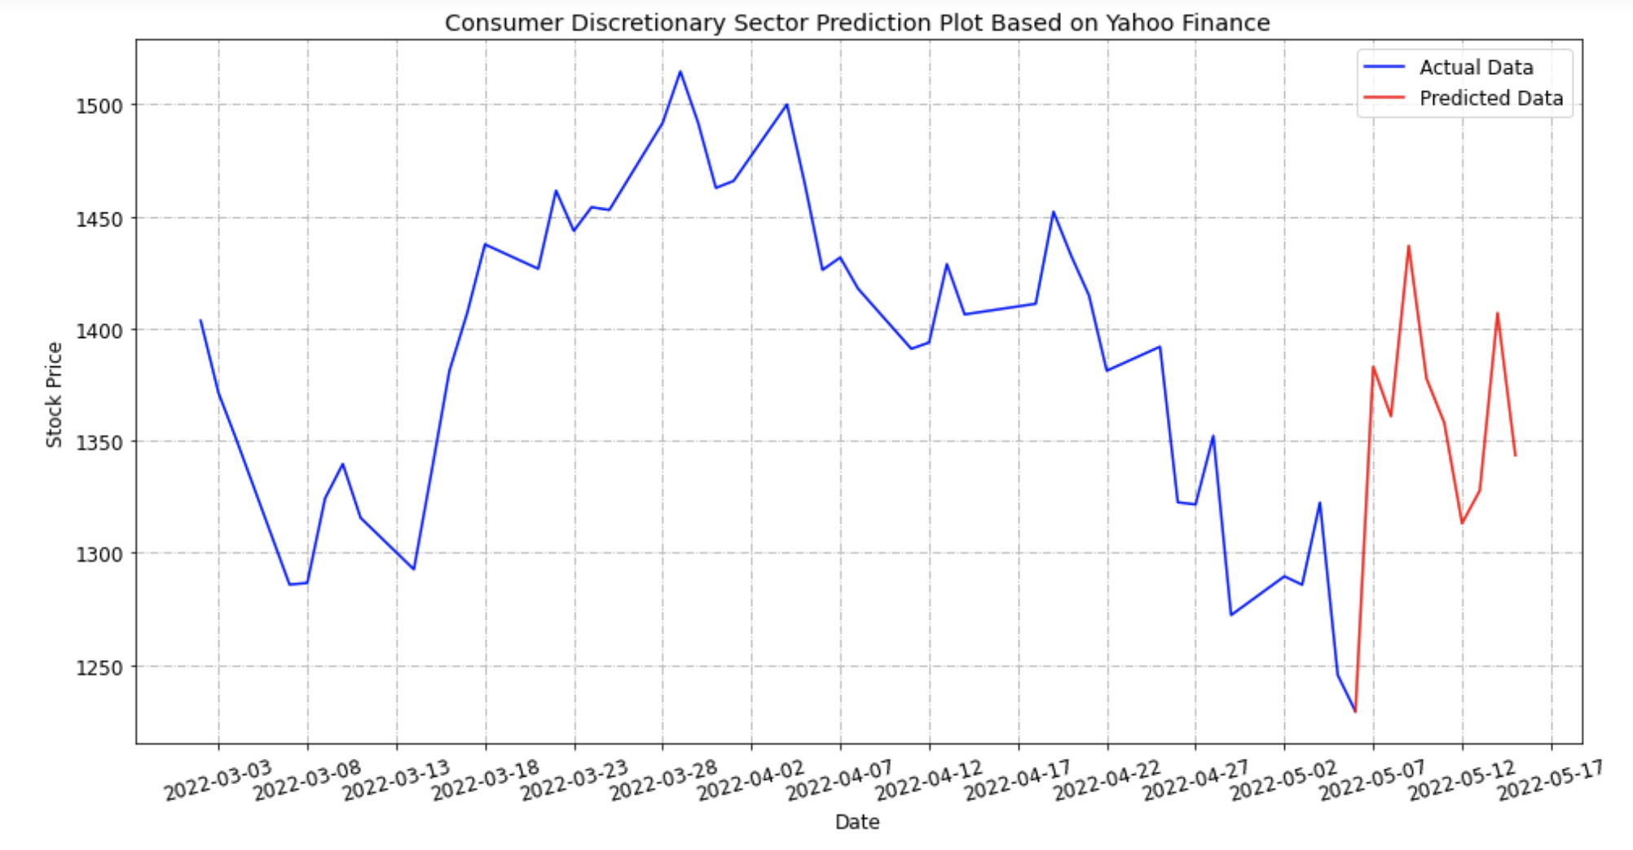
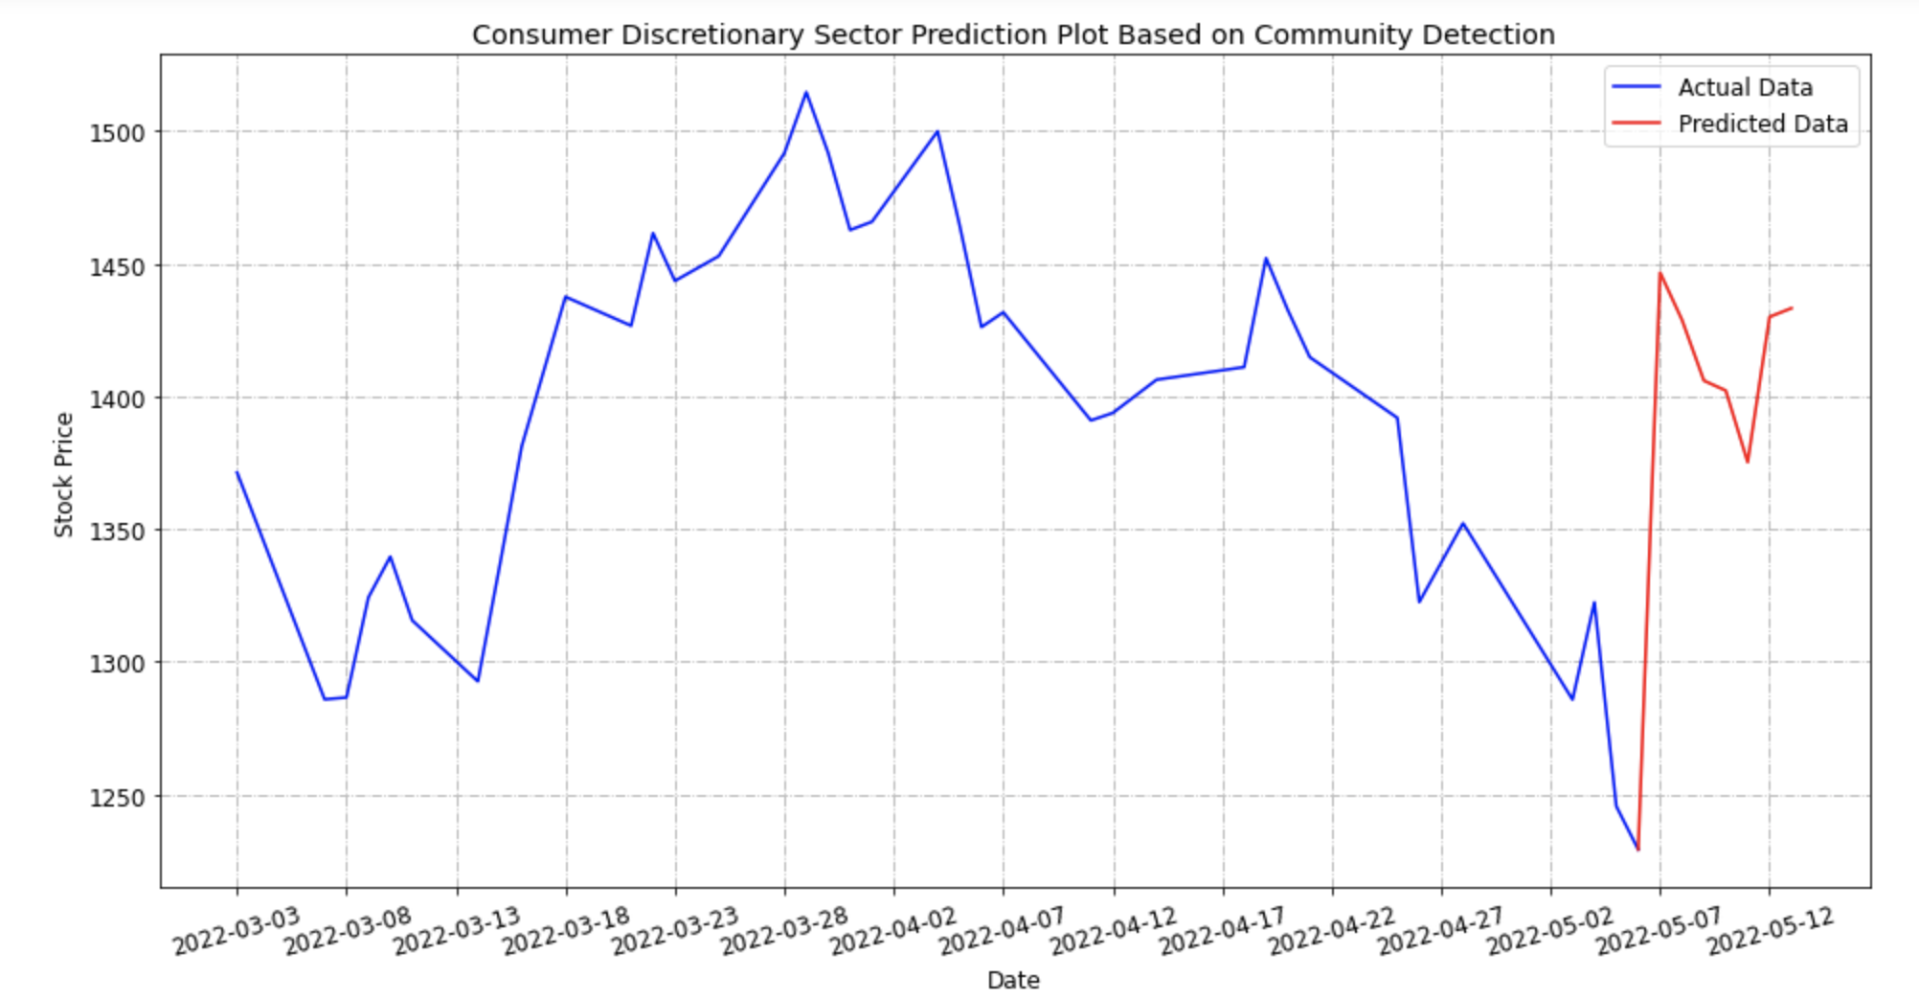
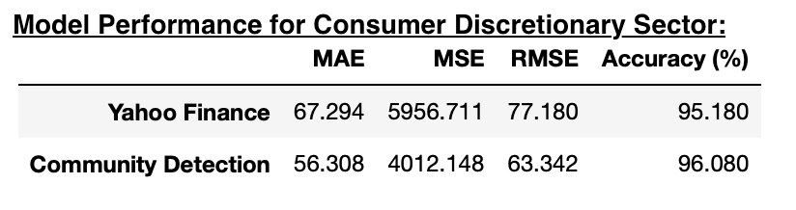
Method 4 – Consumer Discretionary Sector
Evaluation Results:

Slide 16
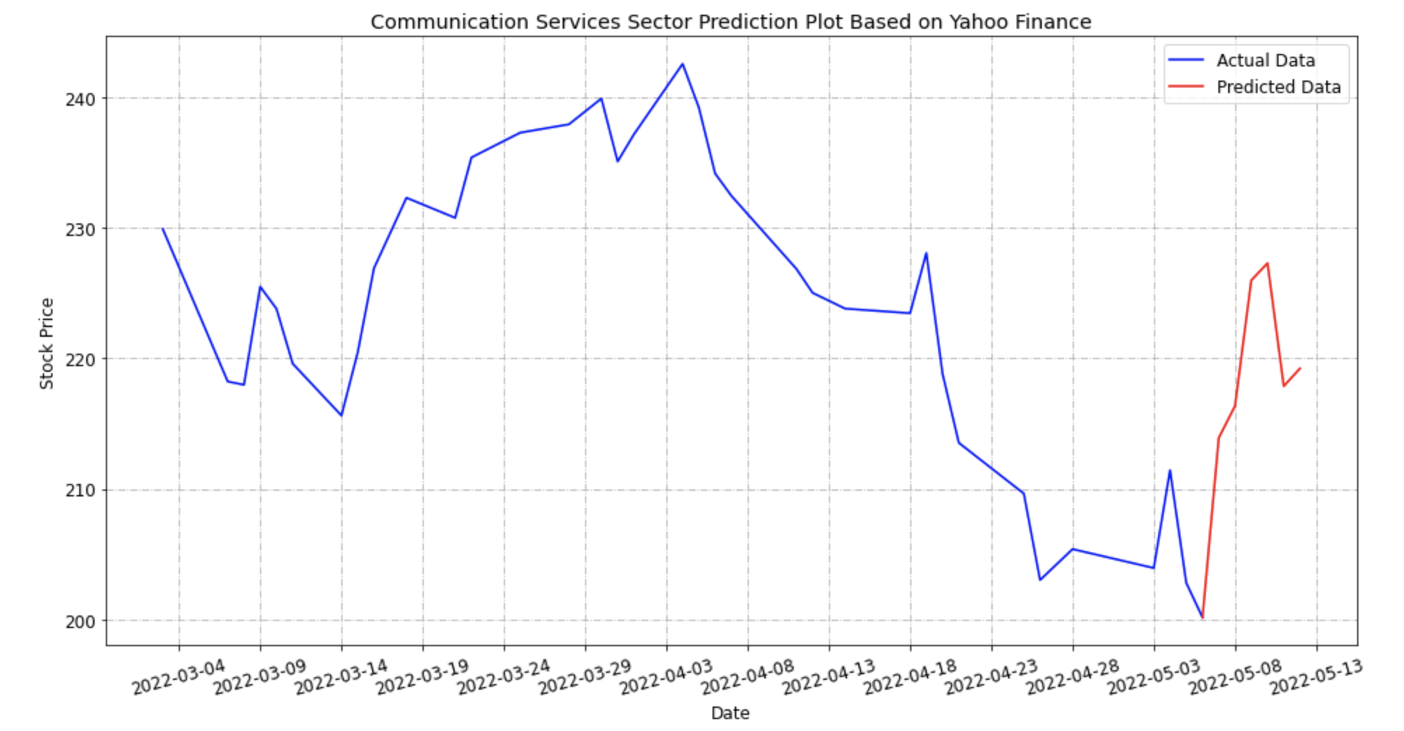
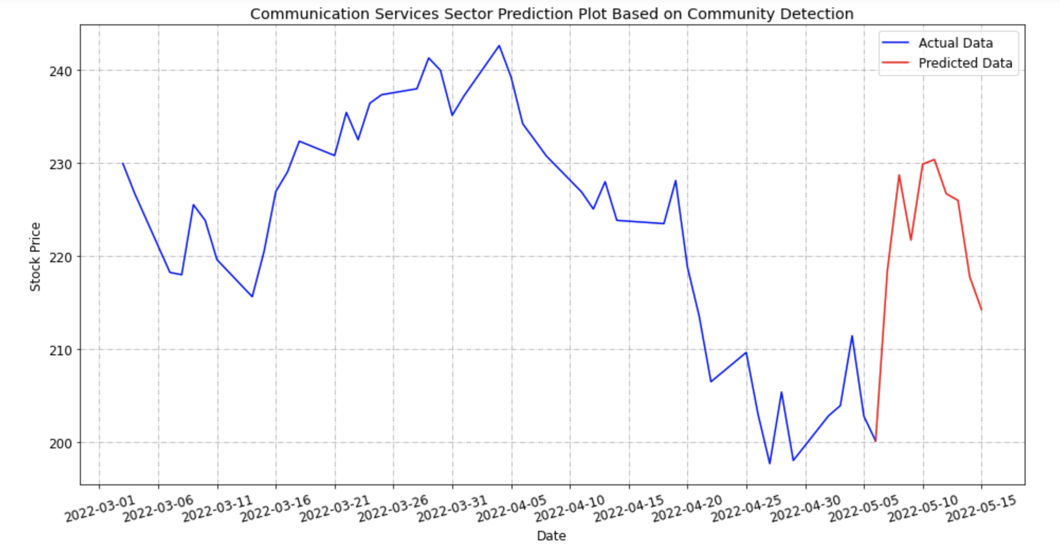
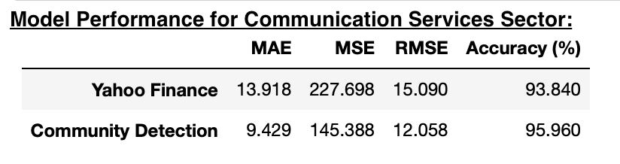
Method 4 – Communication Service Sector
Evaluation Results:

Slide 17
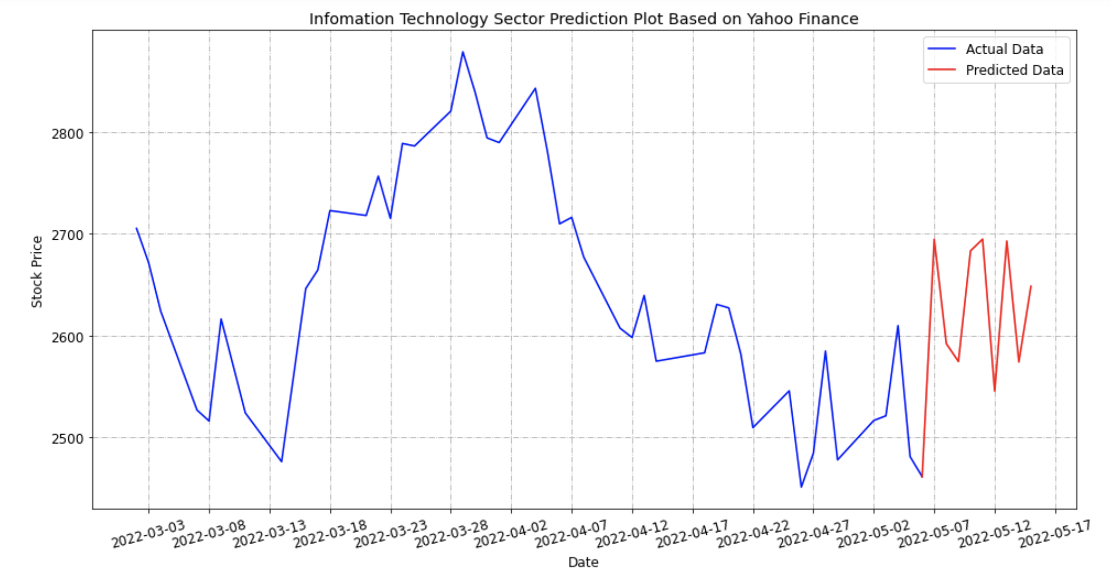
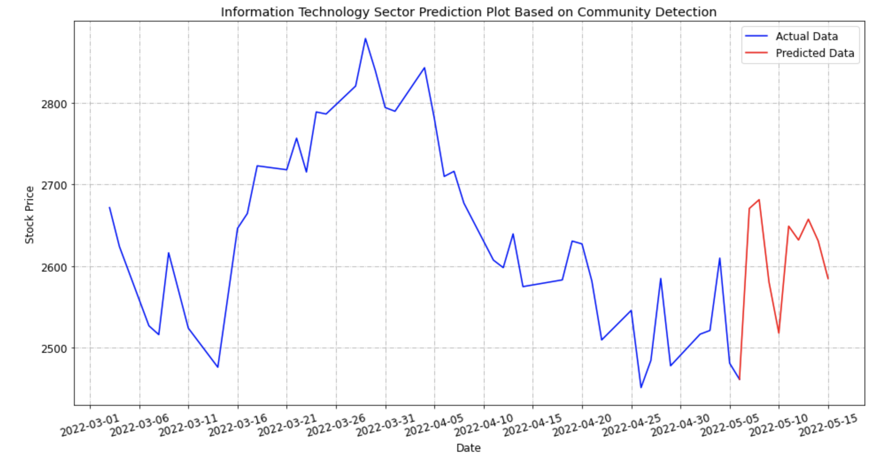
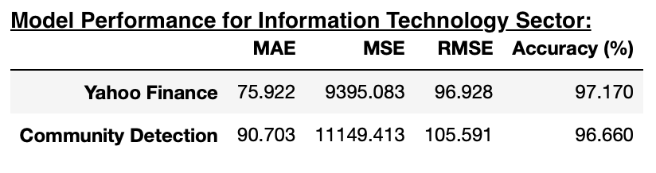
Method 4 – Information Technology Sector
Evaluation Results:
Notes:
However, in information technology sector, the model based on yahoo finance‘s sector has higher accuracy.

Slide 18
Conclusion
When every two stocks have 23 and more investors commenting, the 50 target stocks can be classified into 5 categories by Laplacian matrix analysis.
The accuracy of the prediction model based on the community-detected sector classification is generally greater than the accuracy of the sector classification provided by Yahoo Finance.
Investor sentiment can reasonably predict stock prices.
Notes:
To sum up, I found out

Slide 19
Future Research
Sentiment Analysis
Loughran-McDonald financial sentiment dictionary
VADER Sentiment Analysis
Construct “Investor Sentiment Index”
Trading Volume
Market Turnover
Put-call ratio
Explore all sectors and longer time period
Notes:
instead of using polarity as sentiment score
Since there is lots of emojis in comments, VADER can performs very well with emojis, slangs, and acronyms in sentences
To constructed the sentiment index, I plan to use multiple market-based indicators, Such as, trading volume, market turnover
those indicators directly reflect the investor’s behaviour.
By using the larger dataset to improve the model performance.
Put/call ratio (or put–call ratio, PCR) is a technical indicator demonstrating investors' sentiment.
The ratio represents a proportion between all the put options and all the call options purchased on any given day.

Slide 20
Thank you for listening!

